Slide 1
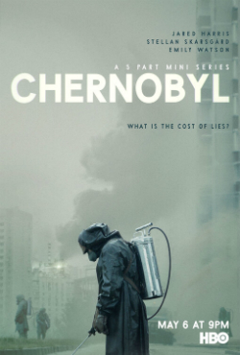
TWO QUESTIONS
One aspect of the miniseries that connects with the themes of ‘science, technology, society’ (Group question; 4-5 sentences)
A character or sequence from the miniseries that you found most interesting/moving. (Individual question: 4- 5 sentences)

